Slide 1


Generative AI
Full Stack Developer
01

Slide 2
Course A : Prompt Engineering
05

Slide 3
04
Advanced Prompt Patterns
05

Slide 4
Agenda
Advanced Prompt Patterns
Guidelines & Recommendations
Objectives:
Strategic use of advanced prompt types
Best practices to write clear, robust, and reliable prompts
05

Slide 5
Advanced Prompt Patterns
In this section, you'll discover key advanced prompting strategies and their applications.
Learn how to craft sophisticated prompts that unlock AI's full potential
Explore patterns that enhance reasoning, consistency, and creativity

Slide 6
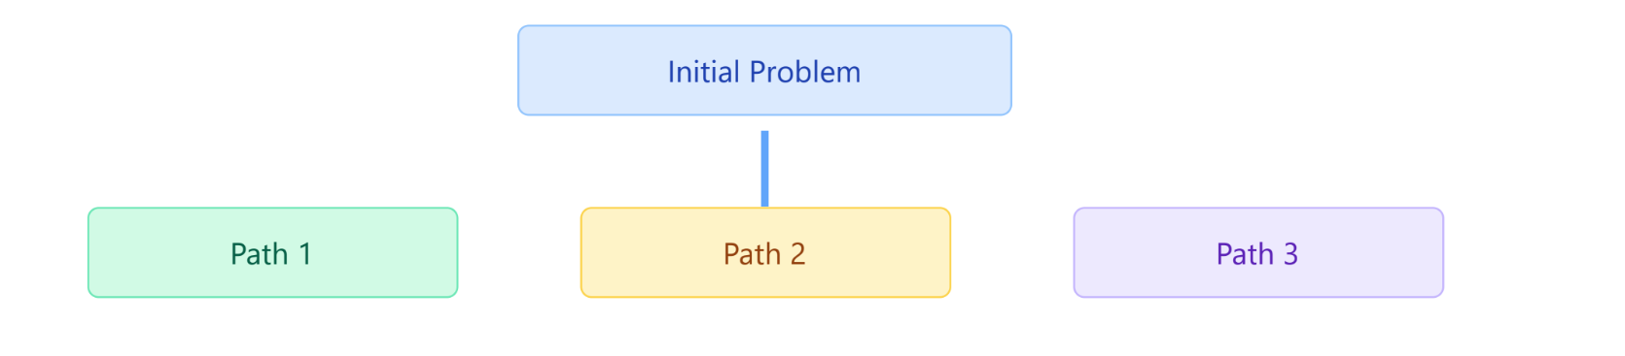
Tree-of-Thought Prompting
Parallel reasoning paths for problem-solving
Why it works: Improves creativity and depth
</> Example: Prompt
"Generate 3 marketing campaign ideas for a new eco-friendly product. Compare their potential ROI and recommend the best."

Slide 7
Self-Consistency Prompting
Run the same prompt multiple times, compare outputs
Use majority voting or scoring
Reduces hallucinations
</> Example: Prompt
"List 5 benefits of remote work." (Run 3 times, then compare)
Run #1
Flexible work hours
No commute time
Better work-life balance
Increased productivity
Cost savings
Run #2
Location independence
No commute time
Custom work environment
Better work-life balance
Reduced office politics
Run #3
No commute time
Flexible work schedule
Better work-life balance
Higher productivity
Cost savings on travel
Consistent Results
No commute time (3/3)
Better work-life balance (3/3)
Cost savings (2/3)

Slide 8
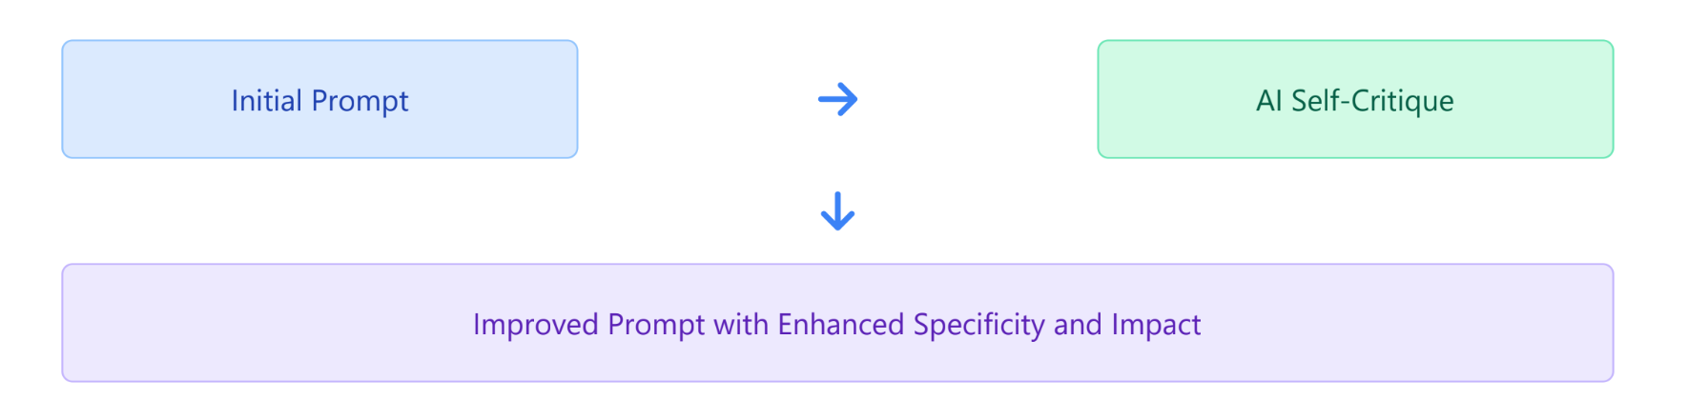
Meta Prompting
Let the model critique or improve prompts or answers
Helps refine prompt quality and output accuracy
</> Example Prompt:
"Here's my prompt: 'Summarize the quarterly report.' Suggest 3 ways to make it more
specific and impactful."

Slide 9
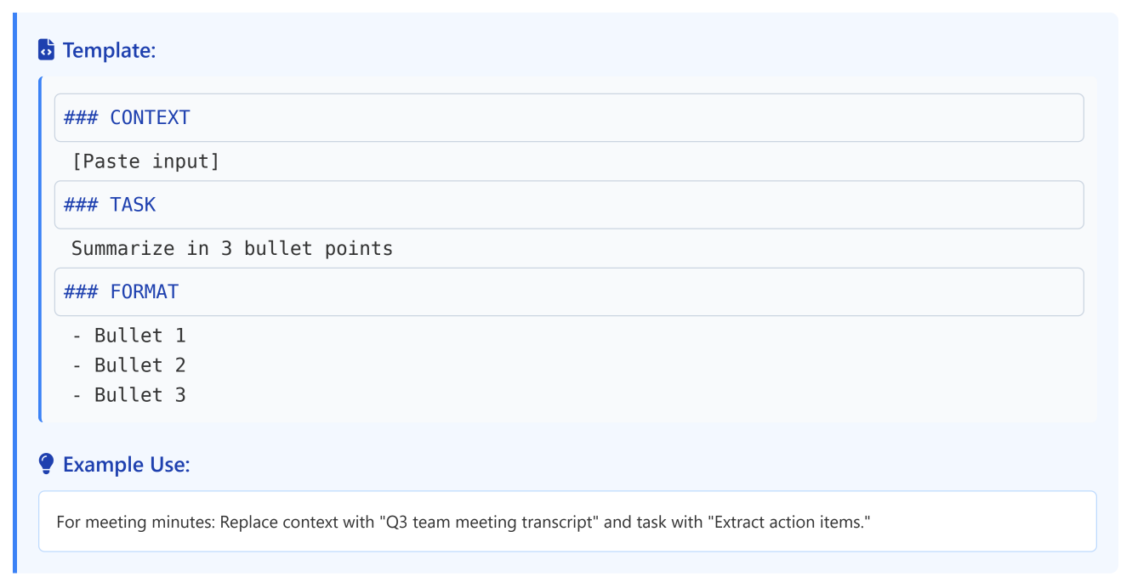
Skeleton Prompt Templates
Use modular structure for consistency and reusability

Slide 10
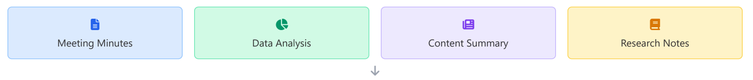

Skeleton Prompt Templates
Use modular structure for consistency and reusability

Slide 11
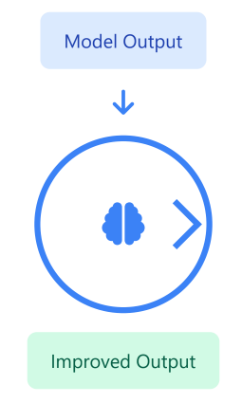
Reflection & Self-Critique Prompts llm-as-judge
Ask the model to reflect on its own outputs
Useful for complex decision-making or bias detection
Example: Prompt
"Review your answer above. Identify any biases or gaps in logic."

Slide 12
Lab A

Slide 13





Multimodal Prompting
Use text + images/charts/code
Especially powerful in analytics, design, or product demos
Text Prompt
Image
Code
Example: Prompt
"Explain the trend shown in this sales growth chart in plain English." (Attach chart
image)
AI Processes Multiple Input Types
Contextually Rich Response Utilizing All Inputs

Slide 14
Positive Framing & Language
Use affirmative instructions instead of negations
Models perform better with what to do, not what not to do
Bad:
"Don't include pricing."
Good:
"Exclude pricing unless requested."
Example: Prompt
"List 3 strategies to increase user engagement. Do not suggest paid advertising."
"Don't do X"
"Focus on Y instead"

Slide 15


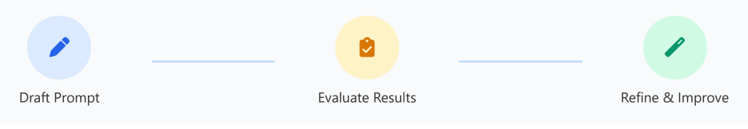
Iterative Refinement & Feedback Loops
Start with a minimal viable prompt, improve over iterations
Track performance across versions
Example Iteration:
Iteration 1: "Summarize this article in one sentence."
Iteration 2:
"Now expand into 3 bullet points."
Iteration 3:
"Add a conclusion for executives."

Slide 16
Lab B

Slide 17
✅ Part 2 – Guidelines & Recommendations
This section provides actionable guidelines and recommendations for writing effective prompts.
Learn best practices to write clear, robust, and reliable prompts

Slide 18
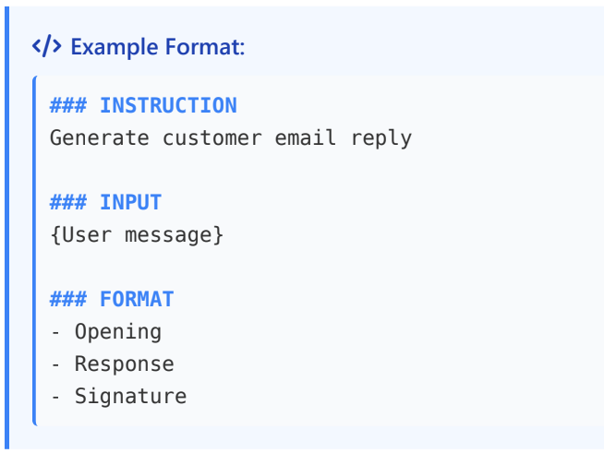
Format & Delimiters
Use structural markers for clarity
Improves readability and model consistency

Slide 19

Format & Delimiters
Without Delimiters
With Delimiters
### TASK
Generate a customer email reply
### CUSTOMER MESSAGE
I received the wrong item. Please help!
### FORMAT
Include greeting and signature
Generate a customer email reply to this message: I received the wrong item. Please help! Include a greeting and signature.
❌ Unclear structure , inconsistent results
Clear structure, consistent results

Slide 20
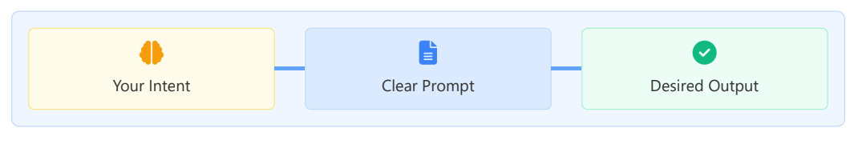
Prompting Philosophy What Are You Really Asking?
Treat prompt like a brief to a junior analyst
Consider your prompt as instructions you'd give to an assistant who is capable but needs clear direction.
Focus on intent and clarity
Be precise about your goals and ensure your instructions are unambiguous and well-defined.
Ask yourself: What do I want the model to do, exactly?
Reflect on the specific output you're seeking before writing your prompt.

Slide 21
Do – Effective Prompting Practices
Define task, tone, and output format
Use consistent templates
Be explicit — never assume
Test with multiple input scenarios
Always validate critical outputs
Clear, structured prompts lead to more reliable outputs

Slide 22
Don'ts – Prompting Pitfalls
❌ Avoid vague verbs like improve or optimize
❌ Don't bundle unrelated tasks
❌ Don't assume domain knowledge
❌ Don't ignore output validation
❌ Don't forget about token cost

Slide 23

Prompting Hygiene – Final Recommendations
Build and reuse modular prompt components
🧠
📊
Track performance and iterate
Evaluate outputs critically
🔍
🔁
Use A/B testing for high-stakes prompts
🔒
Never expose sensitive data to open models
Remember: Good prompting practices lead to better, more reliable AI outputs and can significantly reduce hallucinations and errors.

Slide 24
Q / A

Slide 25
Thanks

